Slide 1
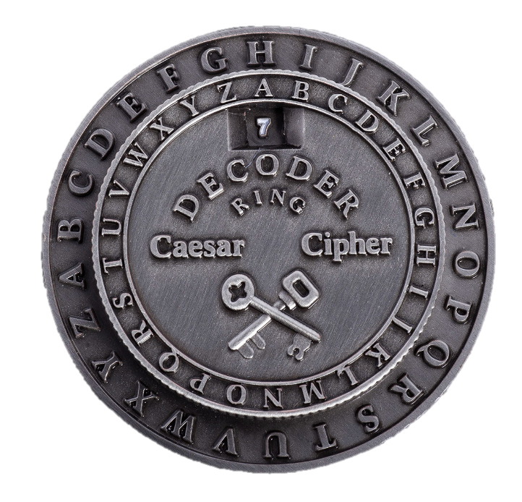
The Caesar Cipher Algorithm
The Caesar cipher algorithm is a simple encryption technique that has been used for centuries. In this presentation, we will explore its history, functionality, strengths, weaknesses, and various applications.
by
Sai Nikhil Reddy Nadikattu
Satish Kumar Pyata
Hariteja Thallapelli

Slide 2

What is the Caesar Cipher Algorithm?
The Caesar cipher algorithm is a substitution cipher that replaces each letter in the plaintext with a letter a fixed number of positions down the alphabet.

Slide 3
The History and Origin
The Caesar cipher algorithm traces its roots back to Julius Caesar who used it to encode sensitive military messages. It's one of the earliest known encryption techniques.

Slide 4

How Does It Work?
The algorithm works by shifting each letter of the message a fixed number of positions. For example, with a shift of 3, 'A' becomes 'D', 'B' becomes 'E', and so on.

Slide 5
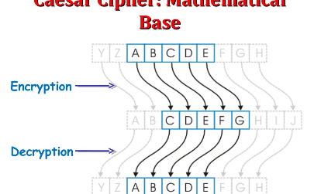
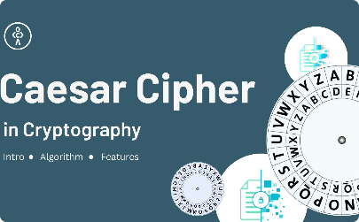
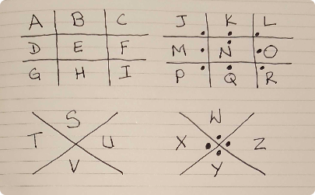
Examples and Demonstrations
Example 1
Example 2
Key
Plaintext: HELLO Shift: 1 Ciphertext: IFMMP
Plaintext: WORLD Shift: 5 Ciphertext: BTWQI
The encryption key determines the number of positions each letter is shifted, ranging from 1 to 25.

Slide 6

Strengths and Weaknesses
Strengths
1. Simplicity: Easy to understand and implement 2. Speed: Quick to encrypt and decrypt small messages
Weaknesses
1. Vulnerable to bruteforce attacks 2. Limited key space: Only 25 possible keys

Slide 7

Applications and Uses
1
Military Communications
The Caesar cipher algorithm was originally used to protect sensitive military communication.
Fun and Games
2
Today, the algorithm is often used in puzzles, escape rooms, and recreational cryptography.
3
Teaching Tool
The Caesar cipher algorithm serves as an introduction to encryption and basic cryptographic principles.

Slide 8

Conclusion
The Caesar cipher algorithm, despite its simplicity, has played a significant role in the history of cryptography. Its strengths, weaknesses, and applications make it an intriguing subject in the field of encryption.
Key Takeaways
- The Caesar cipher is a substitution cipher - It works by shifting letters a fixed number of positions - The algorithm has strengths and weaknesses

